Slide 1

On the Role of STRESS induced mutation in evolution
Yoav ram
Hadany lab – the Evolutionary theory lab
Department of Molecular biology and ecology of plants
Life sciences faculty
Tel-aviv University
May 26 2014

Slide 2
Talk Overview
Mutation rate variability
Stress-induced mutagenesis
Evolution of stress-induced mutagenesis
Consequences of stress-induced mutagenesis

Slide 3
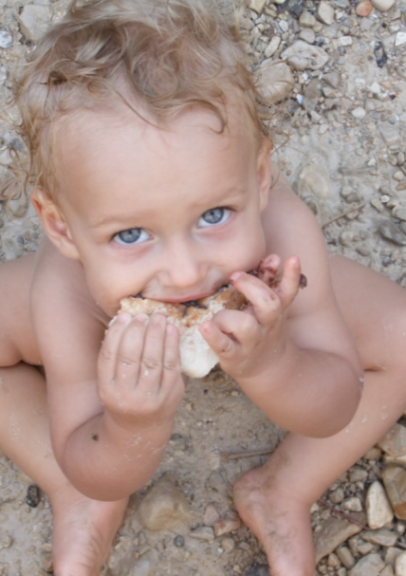
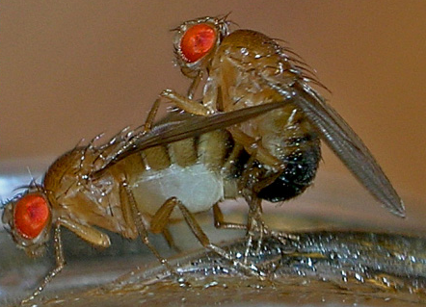
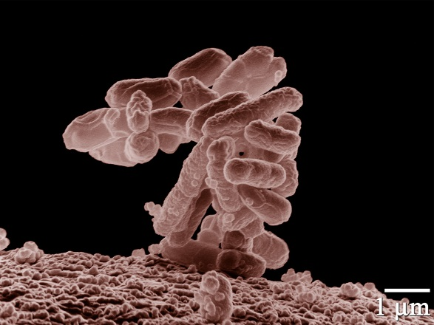
mutation rates Variability
Between species
Average # of measurable mutations per genome per generation
Flies: 0.455
Keightley et al. Gen Res 2009
Humans: 41
Lynch, PNAS 2010
Bacteria: 0.0004
Wielgoss et al. G3 2011

Slide 4
mutation rates Variability
Within species
Mutation rate in 69 natural populations of E. coli Matic et al. 1997

Slide 5
mutation rates Variability
Within individuals
DNA polymerase error rate Lynch 2011

Slide 6
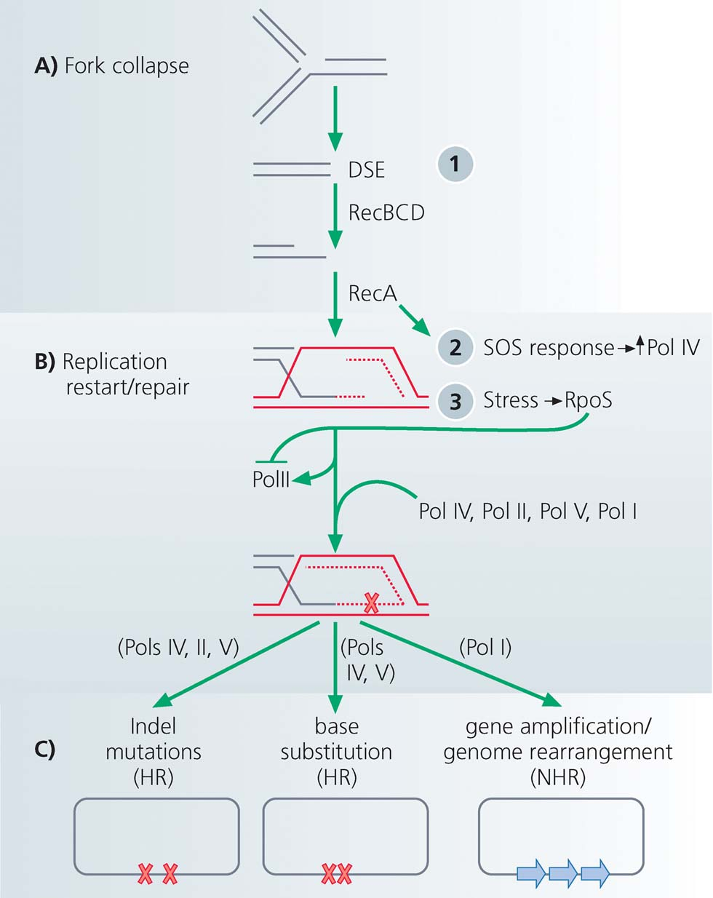
Stress-induced mutagenesis
Rosenberg et al. 2012
In E. coli:
Error prone polymerase induced by stress responses:
SOS response
DNA damage
Starvation
Mismatch repair system
Other mechanisms:
Galhardo et al. 2007
Al Mamun, Science 2012

Slide 7
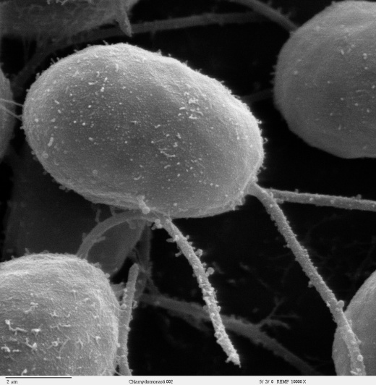
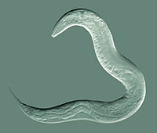
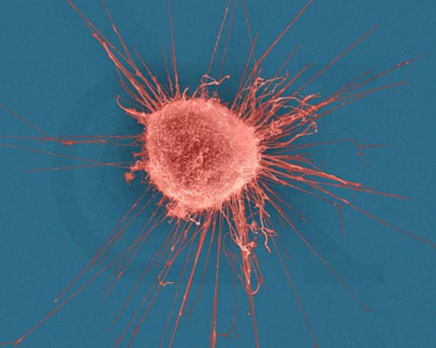

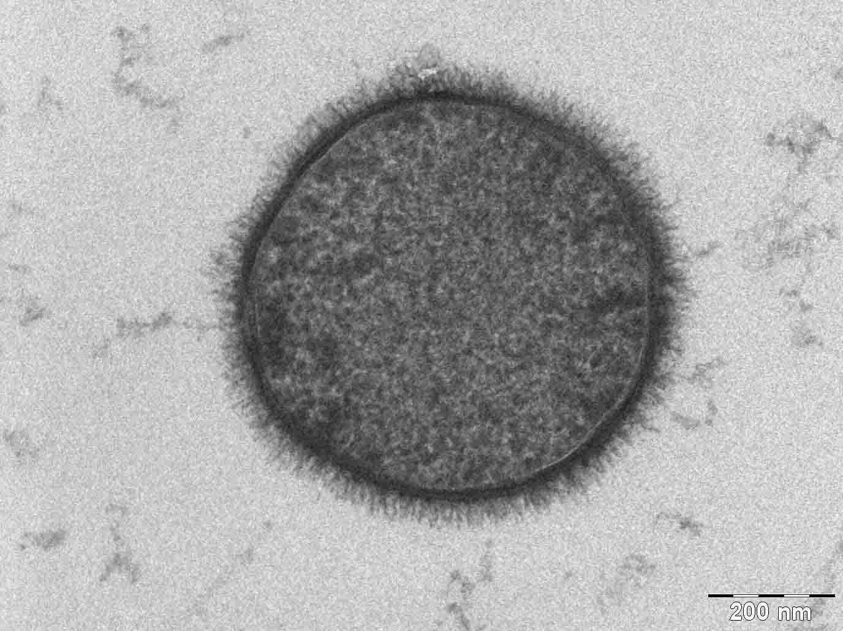
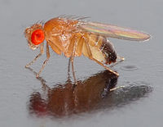
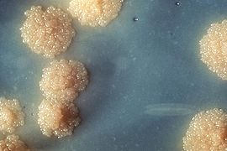
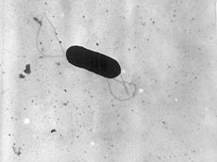
Evidence
Green algea
Nematodes
E. coli
Bacillus subtilis
Breast cancer cell
D. Melanogaster
M. tuberculosis
L. monocytogenes

Slide 8
Evolution of stress-induced mutagenesis
Null hypothesis
Mutagenesis is a by-product of stress
Alternative non-adaptive hypotheses
Cost of fidelity
Drift barrier hypothesis
Adaptive hypothesis
Second-order selection / evolvability

Slide 9
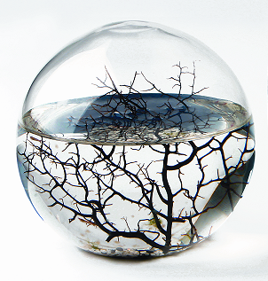
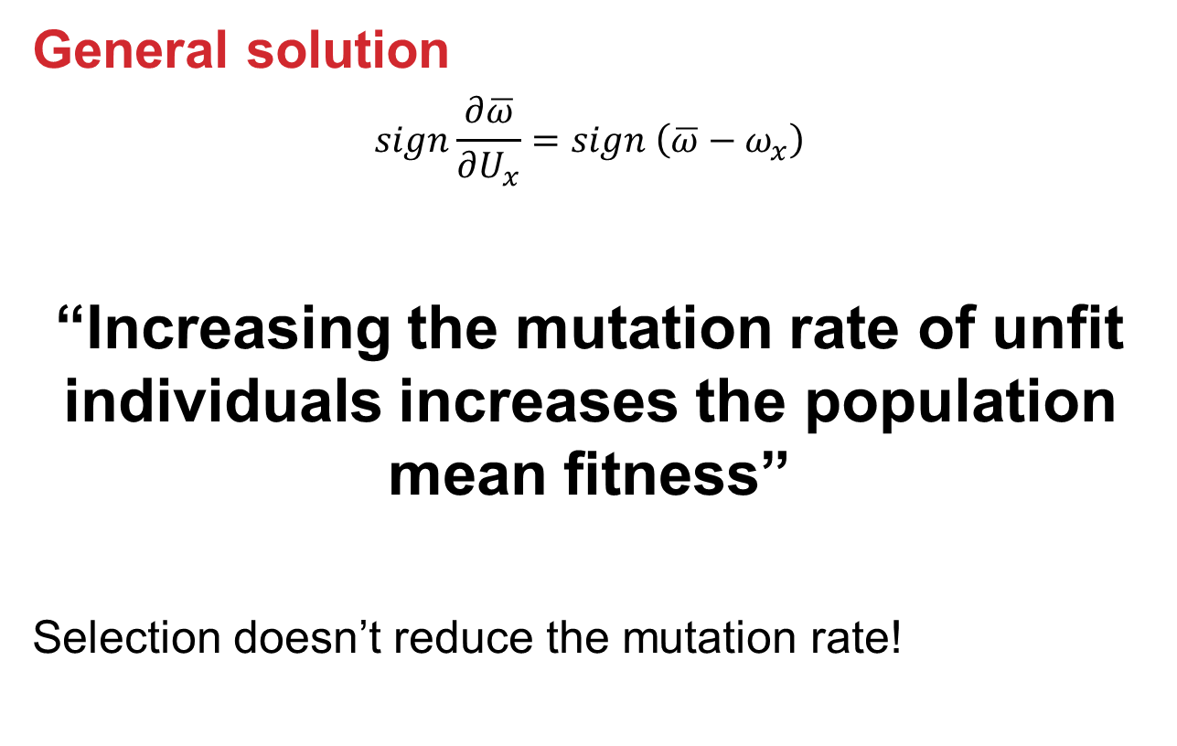
Constant environment: Mutation-Selection Balance
General solution
$$sign\frac{∂\overline{ω}}{∂U_{x}}=sign \left(\overline{ω}−ω_{x}\right)$$
“Increasing the mutation rate of unfit individuals increases the population mean fitness”
Selection doesn’t reduce the mutation rate!

Slide 10

changing environments
The Red Queen hypothesis:
van Valen, 1973
“It takes all the running you can do, to keep in the same place.”
- Lewis Carrol, Through the Looking Glass
What happens if the environment changes frequently?

Slide 11
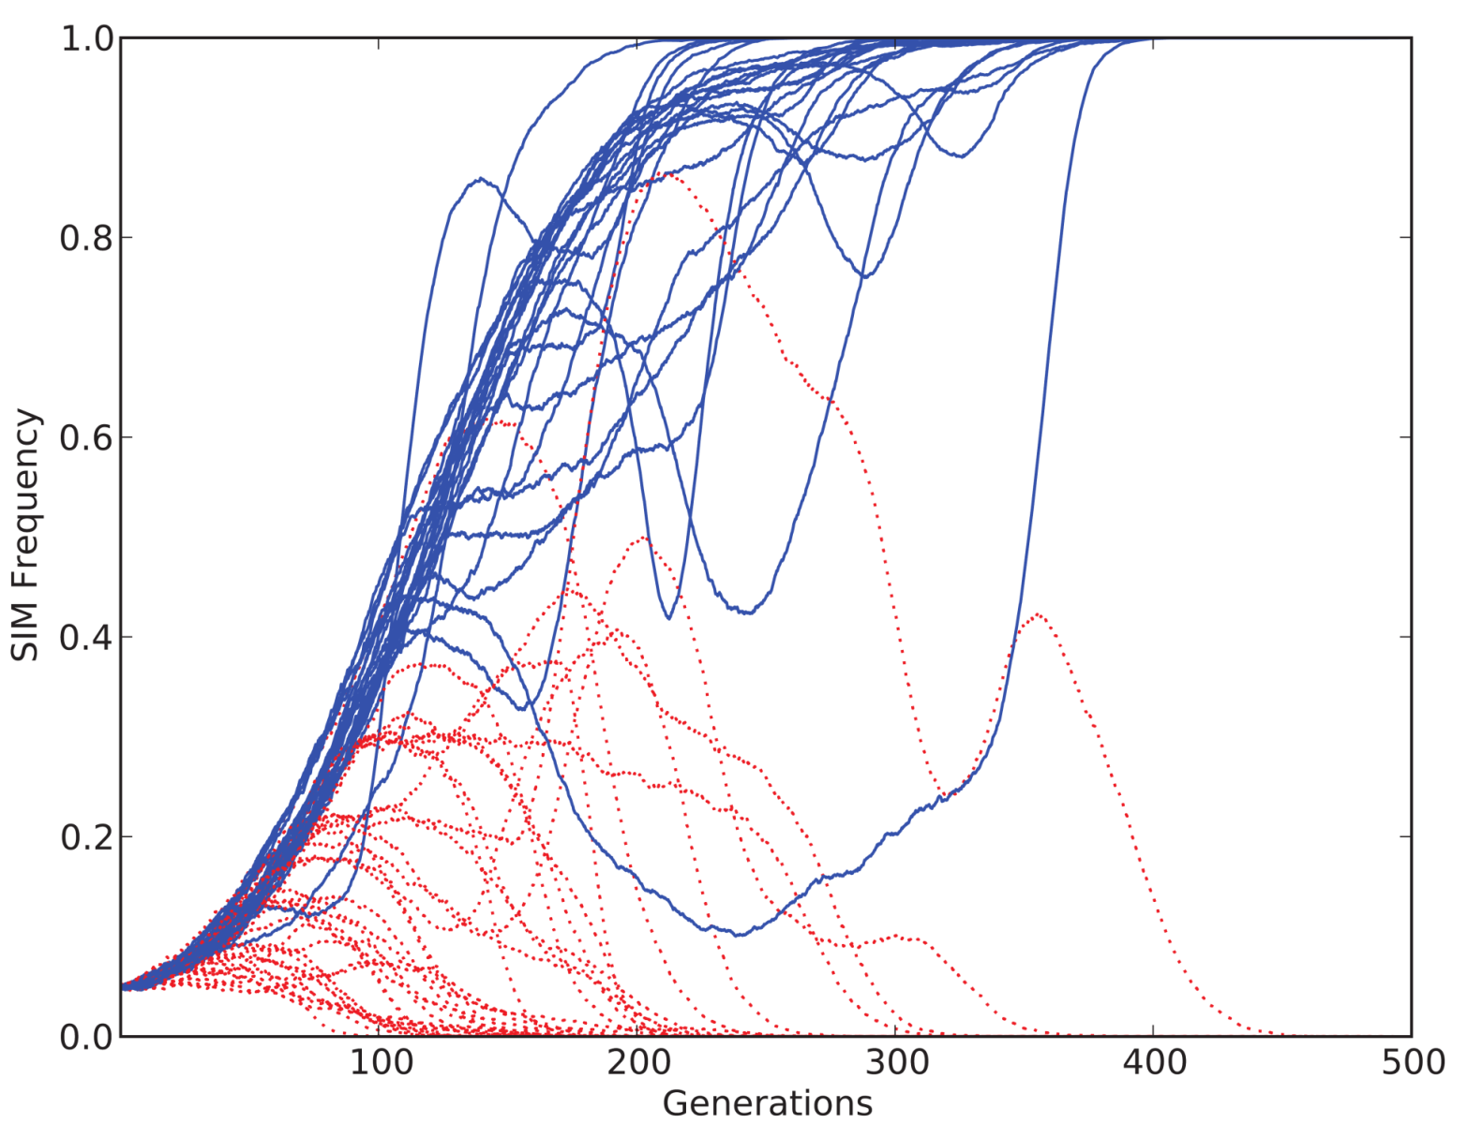
SIM vs. CM
CM: constitutive mutagenesis SIM: stress-induced mutagenesis
SIM Frequency
SIM Wins
SIM losses
Generation

Slide 12
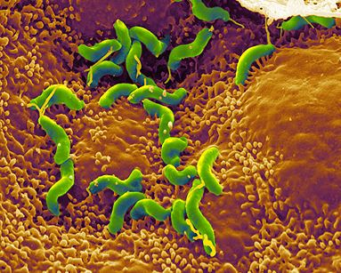
Summary: Evolution of stress-induced mutagenesis
Stress-induced mutators evolve:
In asexual populations
In constant & changing environments
Second order selection can lead to the evolution of stress-induced mutation in asexual populations
Selection for evolvability
H. pylori

Slide 13
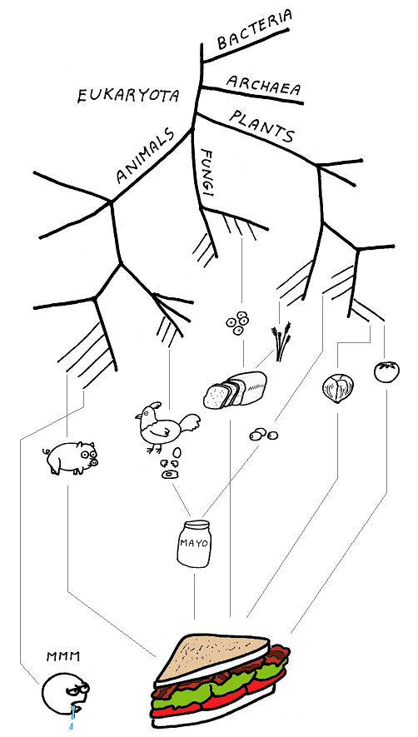
Consequences of stress-induced mutagenesis
What is the role of stress-induced mutagenesis in evolution?

Slide 14
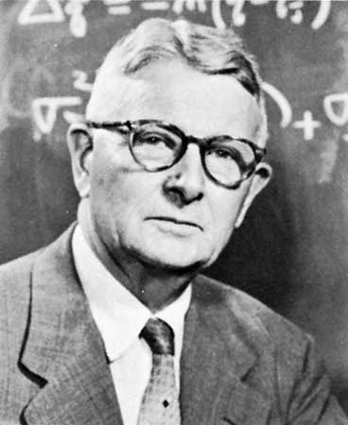
Adaptive peak shifts
This problem was introduces by Sewall Wright in 1931:
If a new adaptation requires several, separately deleterious mutations, how can it evolve?

Slide 15
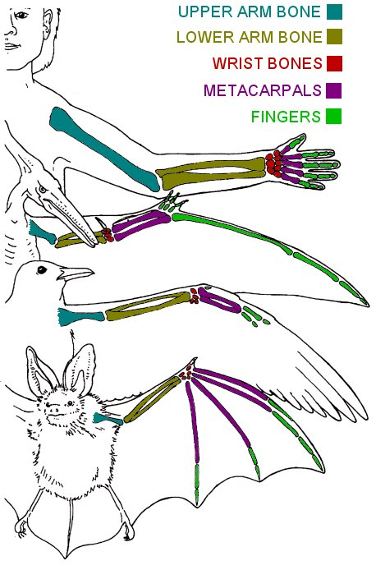
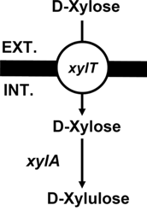
examples
Criteria
Adaptation requires a change in two or more traits
Change in only one trait causes reduced fitness
Wings and bones
Flying with heavy bones is costly
Walking and climbing with light bones is dangerous
New metabolic pathway
Two new proteins required – pump and enzyme
each is wasteful without the other
Xiao et al. 2011

Slide 16

Adaptive Peak shift
←Fitness→
High peak
Low peak
Valley
←Genotype→

Slide 17
SIM & Adaptive Peak shifts
Increasing the mutation rate in individuals below both peaks
High mutation rate
Low mutation rate

Slide 18
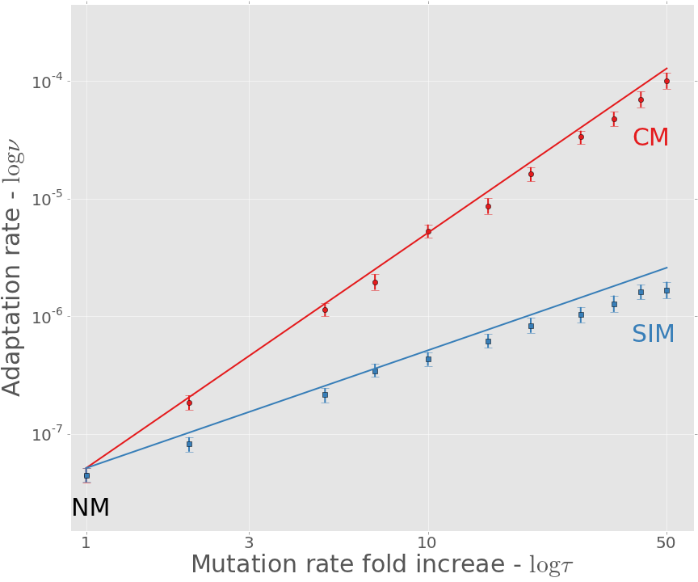
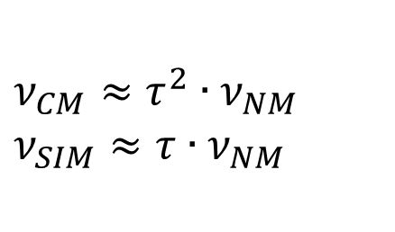
Adaptation rate
$$ν_{CM}≈τ^{2}∙ν_{NM}$$
$$ν_{SIM}≈τ∙ν_{NM}$$
CM: constitutive mutagenesis SIM: stress-induced mutagenesis
Approximation
Simulation

Slide 19
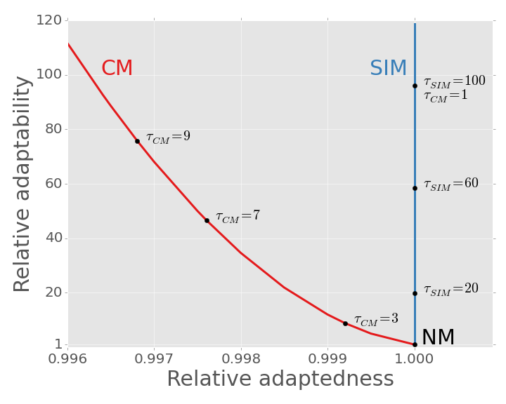
SIM Breaks the trade-off: adaptability & adaptedness

Slide 20
Conclusions
Evolution of stress-induced mutagenesis:
SIM can evolve due to 2nd order selection
In constant and changing environments
Consequences of stress-induced mutagenesis:
Breaks the trade-off between adaptability and adaptedness

Slide 21





Acknowledgments
Lilach Hadany
Uri Obolski
Ariel Guiejman
Manna Center for Plants Biosciences
Amalia Biron-Zigle Foundation
Contact
yoavram@post.tau.ac.il
@yoavram
http://www.yoavram.com

